Slide 1
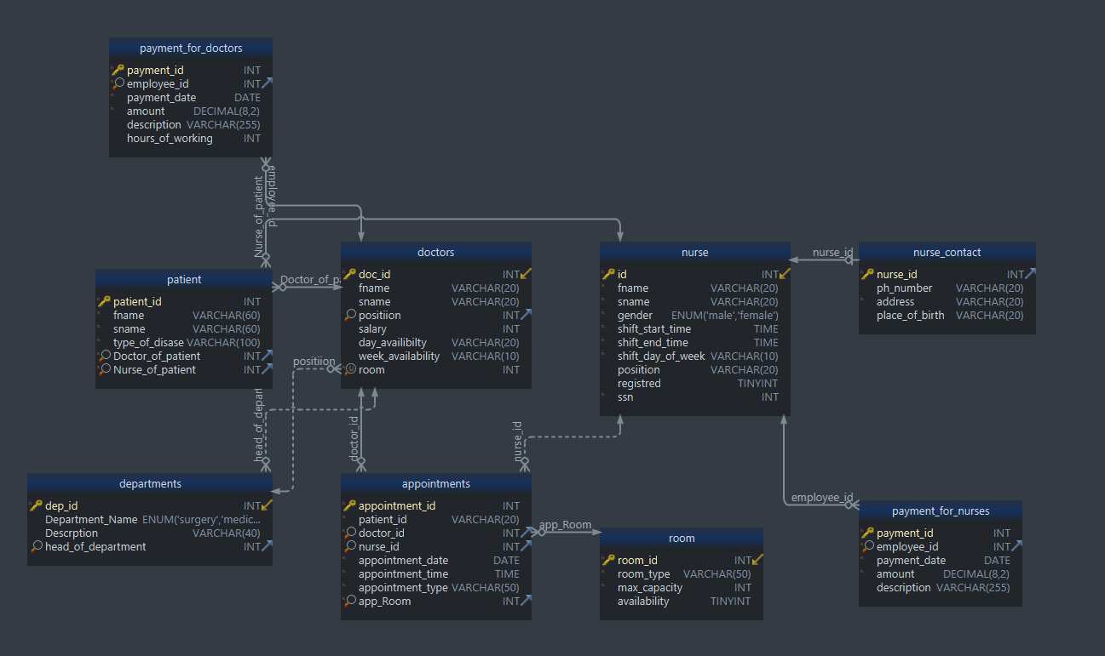
Database : Hospital Management System
Student name one : zaman Dhulfaqar Dasko
Student name two : nuzhin maddhar Salih

